Slide 1
MUGshot
Tight Pickle Productions

Slide 2
Contents
Value proposition
Game rules
Trailer
Concept art
Assets
Prototype game
Wireframe

Slide 3
Value proposition
Beat the high score by killing more!

Slide 4
Game rules
Pretty basic and speaks for themselves.
Run, shoot, dodge
Find the key
Kill everyone
Progression equals harder enemies to beat

Slide 5
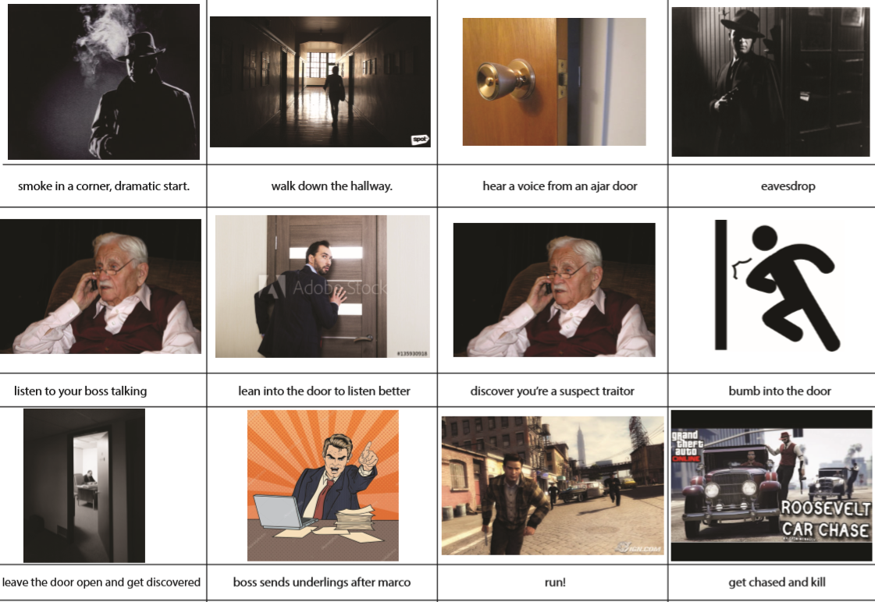
Trailer
Start
Middle
Ending
Start game

Slide 6

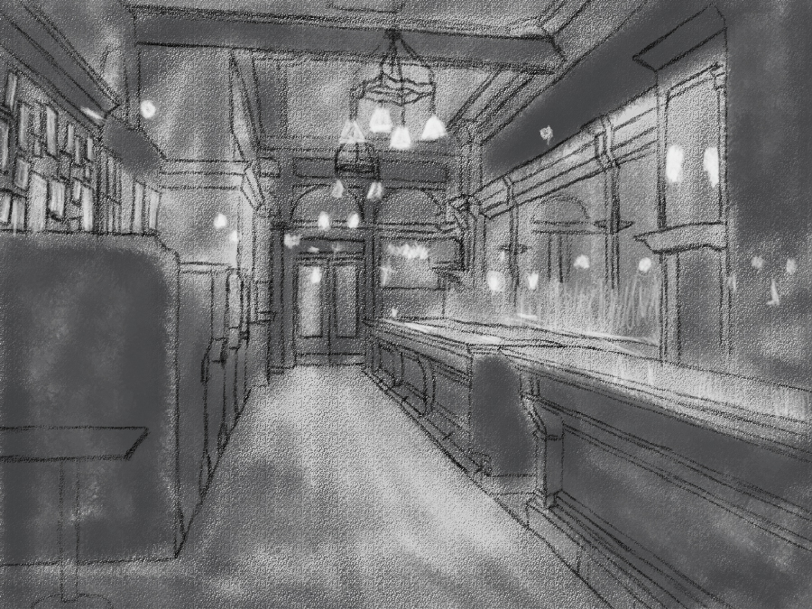
Concept art

Slide 7

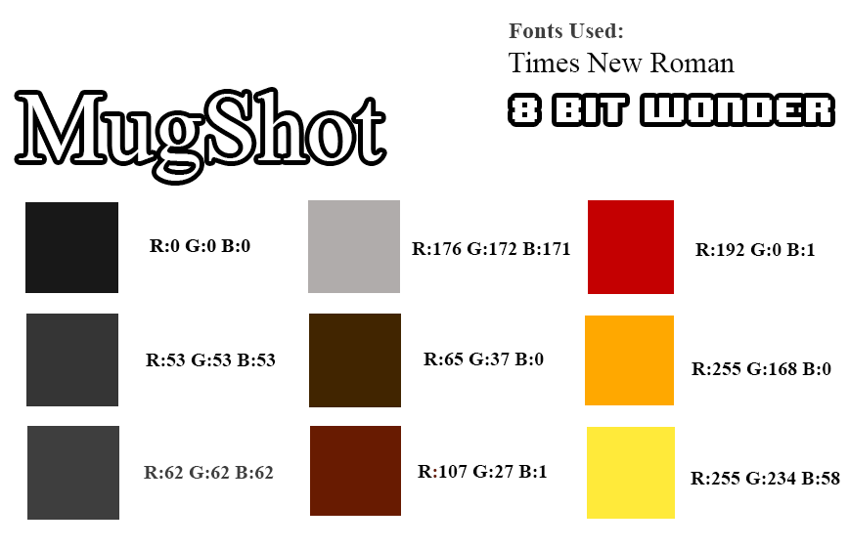

Moodboard

Slide 8
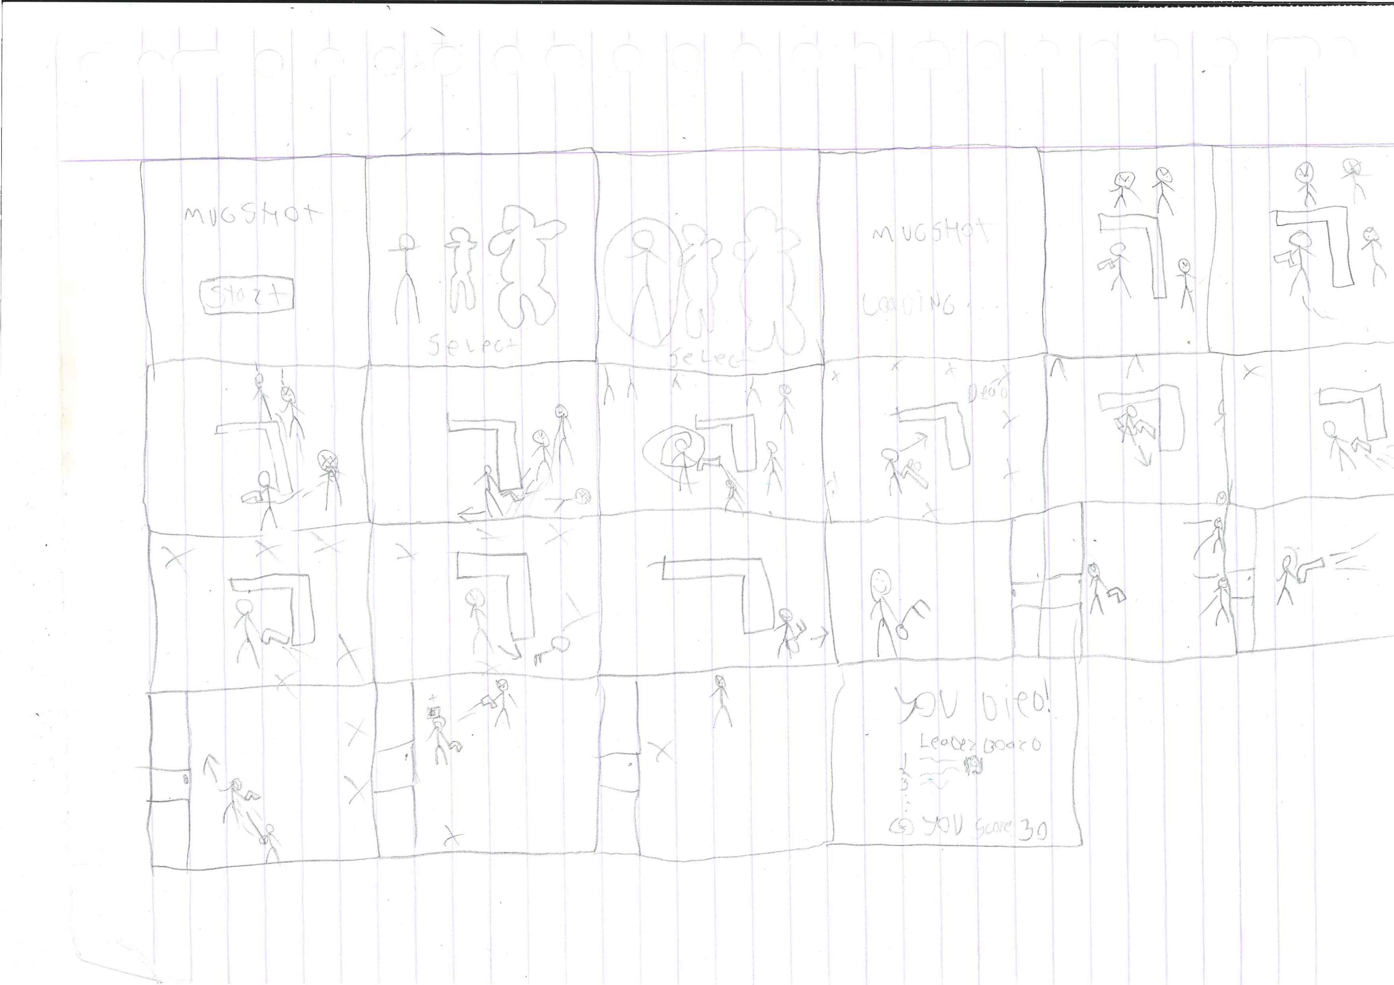
Storyboard

Slide 9
Prototype

Slide 10
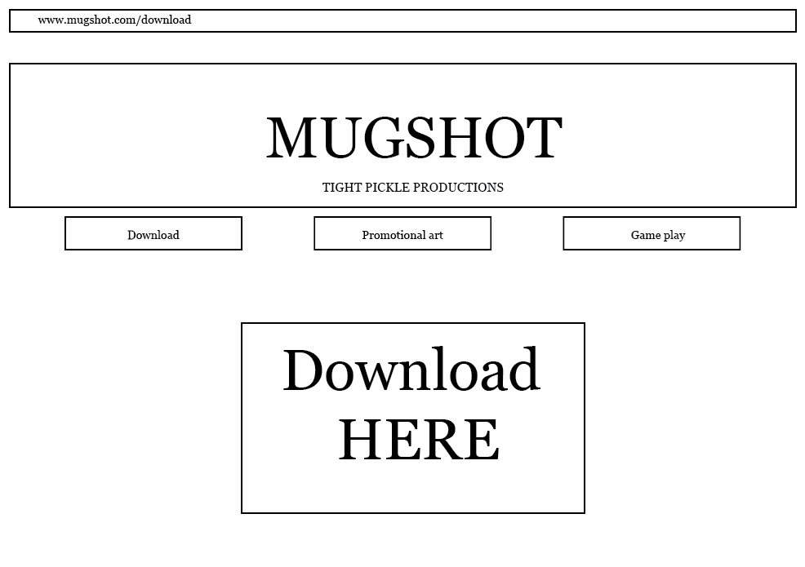
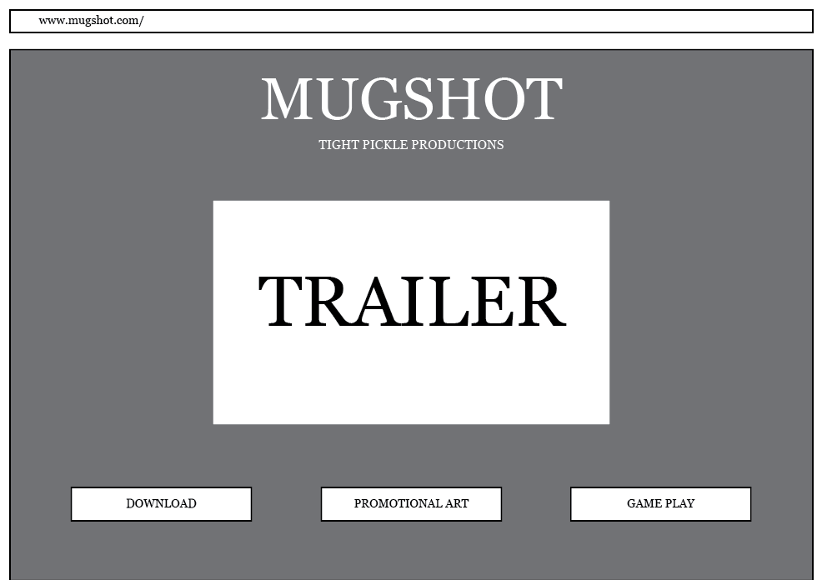
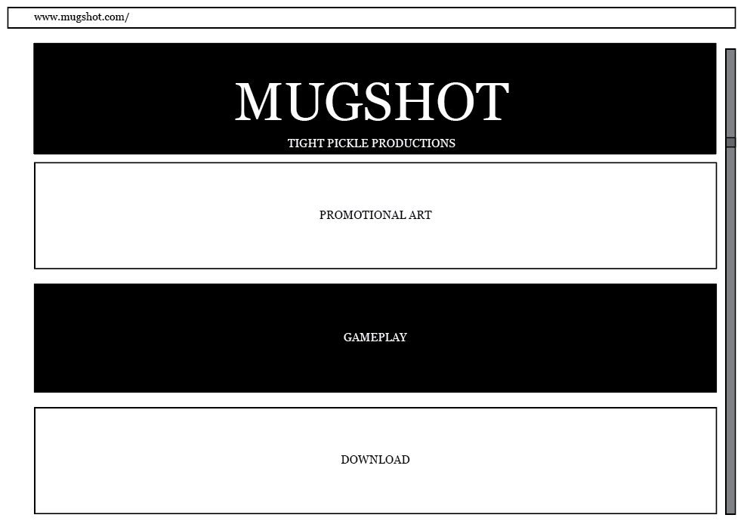
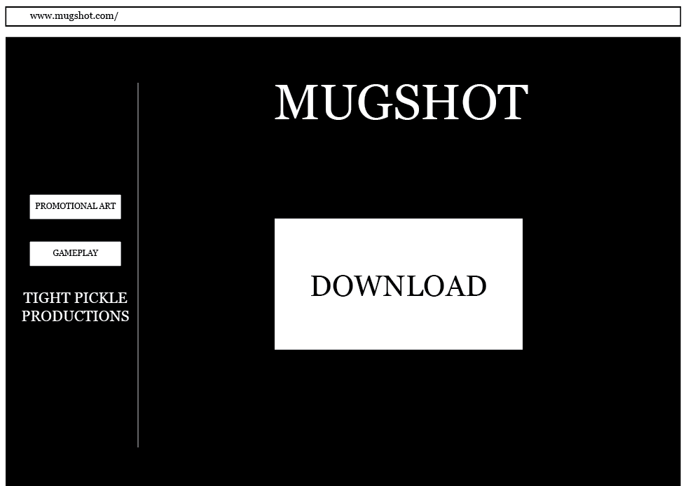
Website Wireframe

Slide 11
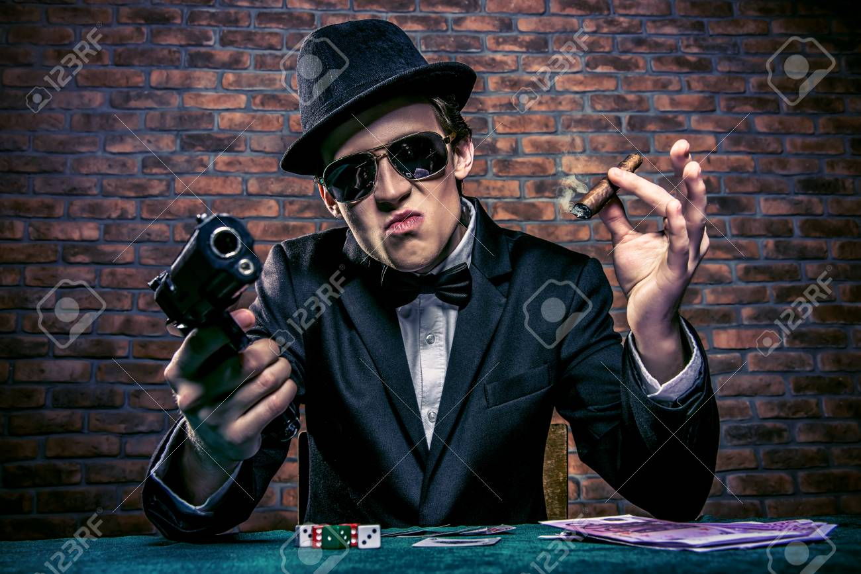
Questions?

